Slide 1

Formatting with LaTeX
IEEE EMBS
Date
IEEE EMBS, 2026

Slide 2
Why would you even use LaTeX when Word and Docs are right there?
Company Name
Date
Short Answer: trust me
Long Answer: LaTeX can improve your text formatting for reports, projects, or even personal documents like resumes

Slide 3
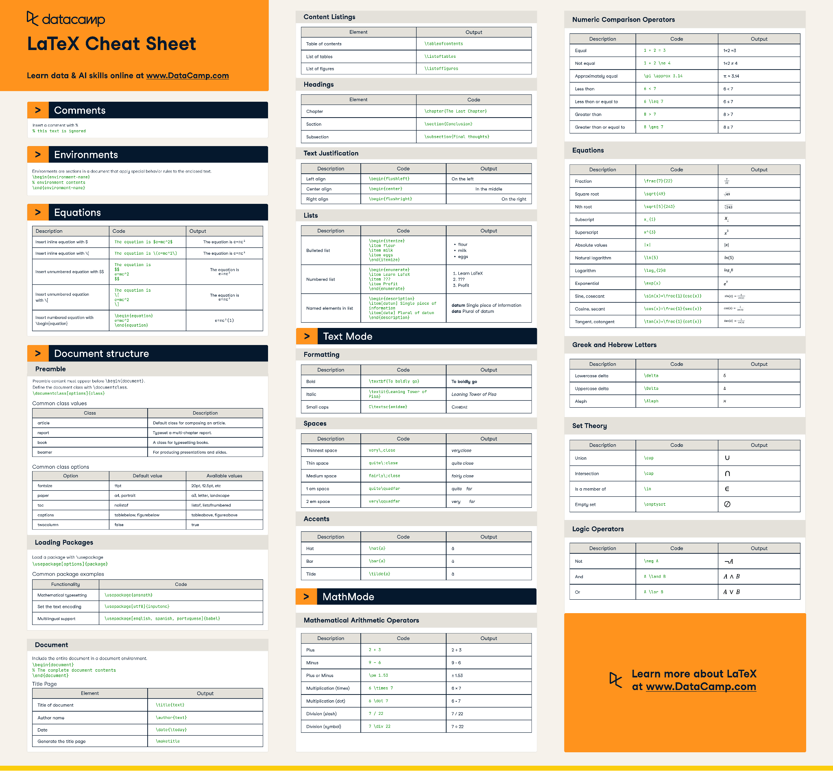

Slide 4

Activity 0:
Make Your First Document
in Overleaf!

Slide 5
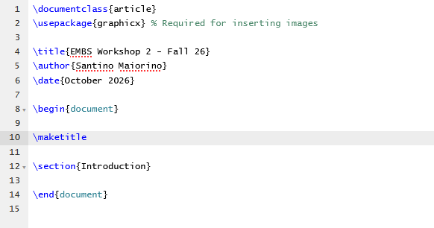
Answer to Activity 0

Slide 6

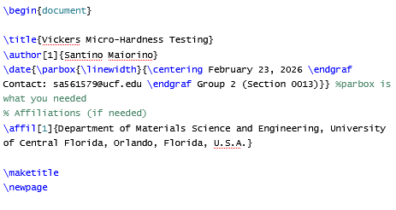
Walkthrough: Title Page

Slide 7
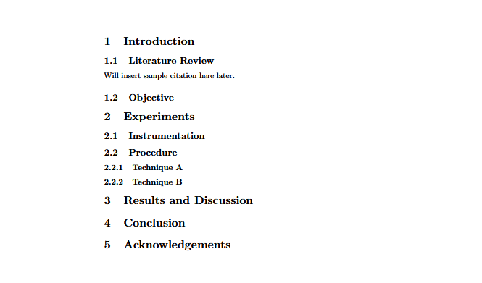
Activity 1:
Headings and Subheadings

Slide 8
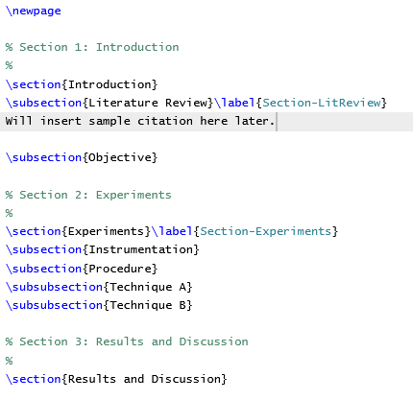
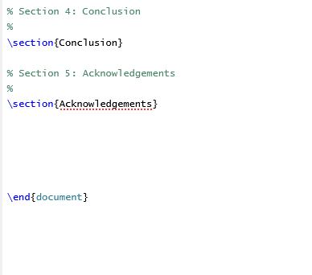
Answer to Activity 1

Slide 9
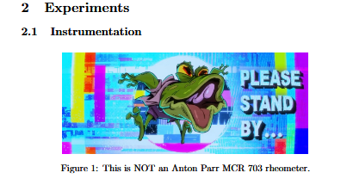
Activity 2:
Adding Images
Hints: 1) create an images folder, 2) keep under 95% size, and 3) use [hbt!] to place your image under the Instrumentation subheading

Slide 10
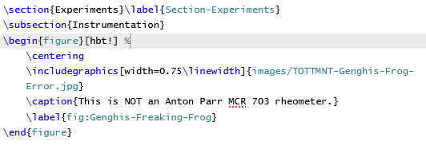
Answer to Activity 2

Slide 11
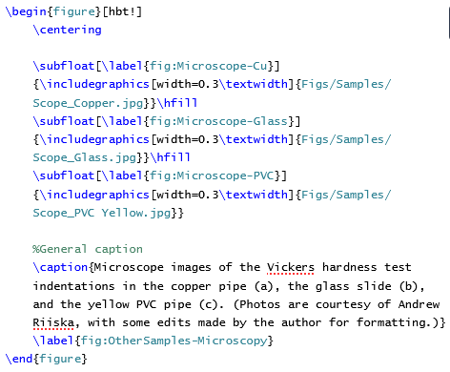
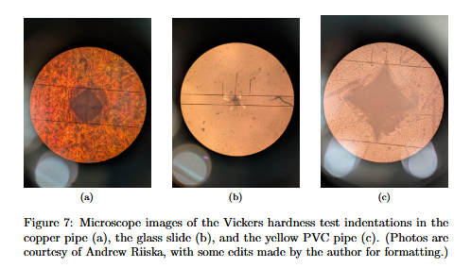
Walkthrough: Multiple Images

Slide 12
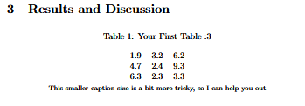
Activity 3:
Formatting Tables
Hints: 1) still use [hbt!], 2) use the default “caption” command for your title, and 3) the commands \begin{tablenotes} and \footnotesize will come in handy for the caption

Slide 13
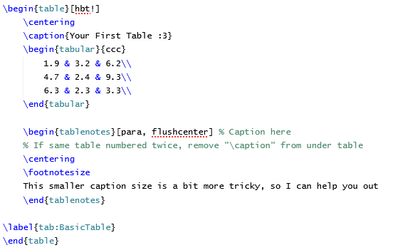
Answer to Activity 3

Slide 14
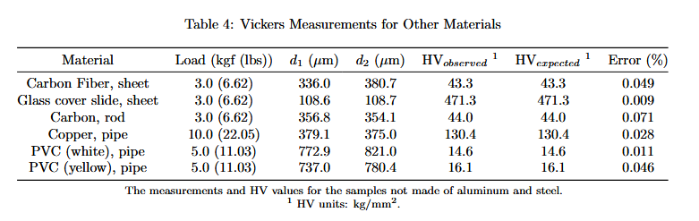
Walkthrough: More Sophisticated Table

Slide 15
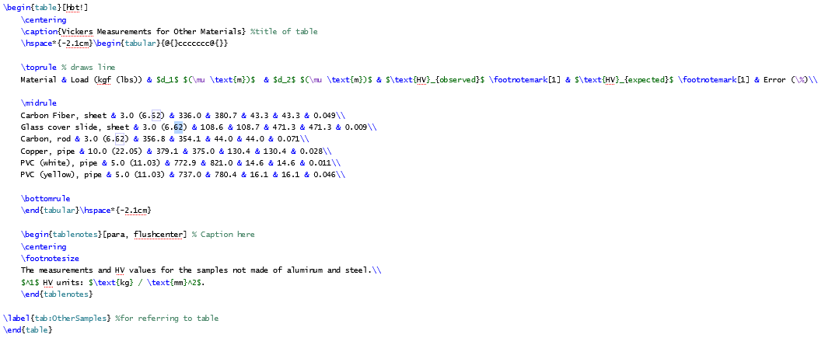
Walkthrough: More Sophisticated Table

Slide 16
Activity 4:
Getting Used to Templates
Look up “Jake’s Resume Template” and “Springer Nature Latex Template”

Slide 17
Thank you!
Company Name
Date
Encourage your audience to provide feedback and continue the conversation at a later date. (No thanks, I’m good! I can do that myself.)
Contact
name@example.com

Slide 18
State the purpose of this presentation or meeting.
Explain why the content is relevant to your audience.
For example, your objective might be to better understand the competitive landscape to recognize business opportunities.
Company Name
Date

Slide 19






Meet the team
Company Name
Date
Full Name
Full Name
Full Name
Full Name
Full Name
Full Name
Title
Title
Title
Title
Title
Title
Write a brief bio of this team member. Mention their background, area of expertise, and how they contributed to the competitive analysis.
Write a brief bio of this team member. Mention their background, area of expertise, and how they contributed to the competitive analysis.
Write a brief bio of this team member. Mention their background, area of expertise, and how they contributed to the competitive analysis.
Write a brief bio of this team member. Mention their background, area of expertise, and how they contributed to the competitive analysis.
Write a brief bio of this team member. Mention their background, area of expertise, and how they contributed to the competitive analysis.
Write a brief bio of this team member. Mention their background, area of expertise, and how they contributed to the competitive analysis.

Slide 20
Meet the team
Company Name
Date
Full Name
Full Name
Full Name
Title
Title
Title
Full Name
Full Name
Full Name
Title
Title
Title

Slide 21
How we conducted our analysis
Company Name
Date
If you repeated steps or iterated on the process, change the conclusion step to show what you repeated.
STEP 1
STEP 2
STEP 3
STEP 4
CONCLUSION
Walk your audience through your process.
At each step, briefly explain the actions carried out by the team.
For example, they might have identified competitors, or defined analysis criteria.
Describe how they interviewed stakeholders, tested with users, and collected industry data.
Eventually, the team arrived at the analysis that you’ll be presenting in the slides ahead.

Slide 22
How we conducted our analysis
Company Name
Date
1. Identified competitors
2. Gathered
data
3. Analyzed and interpreted data
Split your research methodology into phases. For example, as your first step, you might have identified competitors. Walk your audience through this process. What criteria did you use? What kind of competitors did you focus on?
After identifying your competitors, the next step might have been gathering data. If so, what sources did you consult? Did you collect industry reports and customer reviews? Did you conduct surveys and interviews?
Finally, what did you do with all this information? How did you analyze and interpret it? Preview the results of your competitive analysis, which will be presented on the following slides.

Slide 23
Identify and classify your competitors. Place them into quadrants based on how successful they are now — and how prepared they are for the future.
Company Name
Date
Challengers
Leaders
Competitor landscape
List competitors who currently dominate the market, but are not prepared for the future.
List competitors who both dominate the current market and are well-positioned for the future.
List competitors who are successful within their niche, but have no clear plan or roadmap.
List competitors who have a clear vision of the future, but have yet to fulfill their business potential.
If you add a diagram to this slide, explain what it shows. Help your audience make sense of the information.
Niche players
Visionaries

Slide 24
Map your competitors based on price and quality, using a brand positioning graph
Company Name
Date
HIGH PRICE
Competitor landscape
List competitors
in this category
List competitors
in this category
LOW QUALITY
HIGH QUALITY
List competitors
in this category
List competitors
in this category
LOW PRICE
If you add a diagram to this slide, explain what it shows. Help your audience make sense of what they’re seeing.

Slide 25
Your market share, in context
Company Name
Date
Market size
00%
Addressable market
00%
Target market
00%
Market share
If you add a diagram to this slide, explain what it shows. Help your audience make sense of what they’re seeing.

Slide 26
Share your vision about where the market is heading, based on the latest trends
Company Name
Date
Market trends
Identify a market trend
Identify a market trend
Identify a market trend
Explain why you consider this to be a current or future trend. Support your case with sales data, user interviews, media coverage, industry reports, etc.
Explain why you consider this to be a current or future trend. Support your case with sales data, user interviews, media coverage, industry reports, etc.
Explain why you consider this to be a current or future trend. Support your case with sales data, user interviews, media coverage, industry reports, etc.

Slide 27
1. Explain a current or upcoming market trend
Show evidence of the trend.
Mention a case study, summarize a report, etc.
Company Name
Date
Market trends
Present a case study
Explain why this is an important trend, how it’ll impact your business, and how your competitors are responding to the challenge.
LINK TO FULL REPORT
Share the latest sales data or industry metrics that support or signal this trend.
Metric description
Metric description
00
00

Slide 28
1. Identify a current or upcoming market trend
Company Name
Date
Market trends
Share the latest sales data or industry metrics that support or signal this trend.
Metric description
00
Explain why this is an important trend, how it’ll impact your
business, and how your competitors are responding to the challenge.
Metric description
00
Present a case study
Present a case study
Show evidence of the trend.
Mention a case study, summarize
a report, etc.
Show evidence of the trend.
Mention a case study, summarize
a report, etc.
Metric description
00
LINK TO FULL REPORT
LINK TO FULL REPORT

Slide 29
Make a claim about what your company needs to do to succeed
Company Name
Date
Success factors
Highlight a key attribute of successful brands in your market or industry.
Highlight a key attribute of successful brands in your market or industry.
Highlight a key attribute of successful brands in your market or industry.
Competitor name
Competitor name
Competitor name
Describe an example of this success factor in action. Explain how it has contributed to the competitor’s business.
Describe an example of this success factor in action. Explain how it has contributed to the competitor’s business.
Describe an example of this success factor in action. Explain how it has contributed to the competitor’s business.

Slide 30
Competitive analysis
Company Name
Date
YOUR COMPANY
COMPETITOR 1
COMPETITOR 2
PRODUCT OR SERVICE
-
-
PRODUCT OR SERVICE
-
PRODUCT OR SERVICE
-
PRODUCT OR SERVICE
-
PRODUCT OR SERVICE
-

Slide 31
Now you’ve reviewed the results of the analysis, write a memorable conclusion that sets up your key takeaways.
Company Name
Date
Success factors
Summarize a key takeaway. Refer to the concrete findings you presented in the previous slides.
Summarize a key takeaway. Refer to the concrete findings you presented in the previous slides.
Summarize a key takeaway. Refer to the concrete findings you presented in the previous slides.

Slide 32
Summarize a key takeaway. Reference the findings you presented in the previous slides.
Company Name
Date
Key takeaways
00
00
What we found
List the data, trends, and factors that support this takeaway
Restate your most important findings
List any additional details you want your audience to remember
Metric description
Metric description
A few words about a relevant trend that illustrates and supports this takeaway.
Logo
Logo
Main competitors

Slide 33
Establish action items based on your key takeaways
Company Name
Date
Next steps
Recap a key takeaway
Make this takeaway actionable. Suggest what your company or organization can do in response to your analysis.
Recap a key takeaway
Make this takeaway actionable. Suggest what your company or organization can do in response to your analysis.
Recap a key takeaway
Make this takeaway actionable. Suggest what your company or organization can do in response to your analysis.
Recap a key takeaway
Make this takeaway actionable. Suggest what your company or organization can do in response to your analysis.

Slide 34
Any questions? Ask away!
Company Name
Date
Give your audience space to resolve immediate questions or concerns.

